Slide 1

MantidPlot: The Next Generation
MANTID User Meeting
12th June 2017

Slide 2
MantidPlot: Survey Comments
MantidPlot critical or very important to day-to-day work for ~65%
Comments:
Improve stability
Improve data plotting
better quality figures for publication
simpler plotting
not able to produce Matplotlib figures within
Mantid, often just do plotting in Python outside of Mantid

Slide 3
MantidPlot: History
Adapted from legacy application QtiPlot - based on Origin
based on Qwt plotting library not widely used
Stuck on old version of Qt
Prevents use of newer features for more modern displays & hardware, e.g. high resolution display support
No longer supported
Inherited code structure makes automatic testing difficult/impossible

Slide 4
Proposal
Develop a new graphical interface written in Python
Use matplotlib as primary graphing package:
already has well defined plotting commands
plenty of active users in the scientific community
Define own features and implement with much improved support for automated testing improved reliability

Slide 5
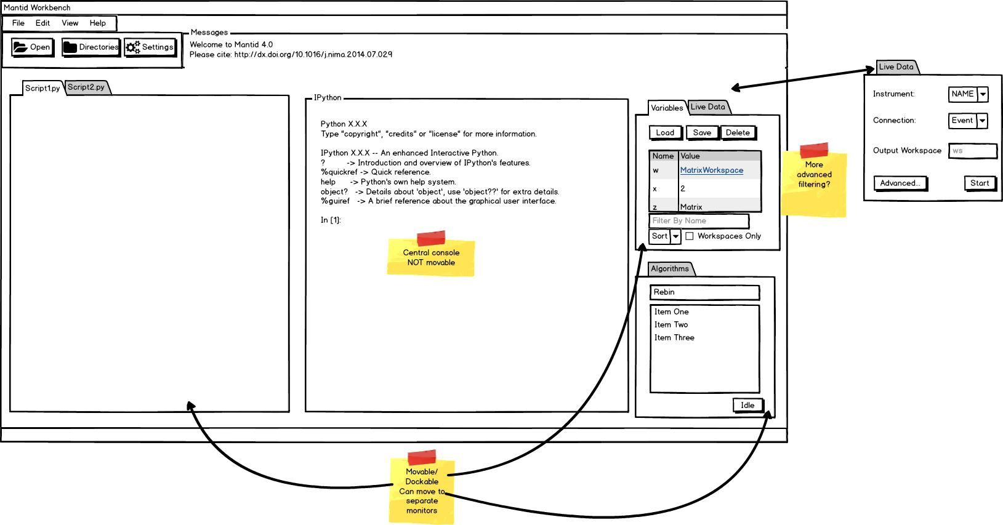
“Lite” Mode?

Slide 6
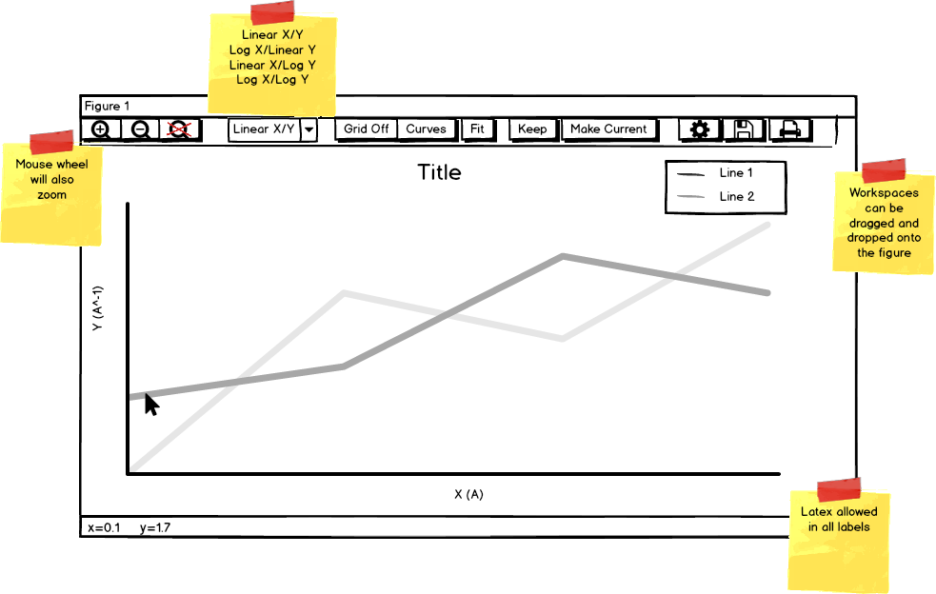

Slide 7
Figure Management: Keep/Make Current
Mechanism inspired by mslice application
A figure can be set as “Keep” or “Make Current”
“Keep” means leave a figure as it is and new plots open a new window
“Make Current” sets that figure active and new plots replace in that window
Overplotting of 1D plot uses separate “plot over” button when you request the plot along with separate plot over python command

Slide 8
